Slide 1


Loan Default Analysis
Sylvester William Lall
Saud Alkoheji
Kalpana Prasad

Slide 2
Agenda
Objective
Data Analysis
Feature Analysis
Final Model
What’s Next?
Algorithm
Introduction
SWOT Analysis
Conclusions

Slide 3

Introduction
Contributes 3.3% to Canada’s GDP
Loans make money through Net Interest Margin
Highly Regulated
Taxes paid in 2019 - $2.7 billion
Consumer credit 2019 (non-mortgage)
- $ 17.6 billion

Slide 4

Objective
Bank loans – profitable, but risky!
Bank loan default – classic use case for ML modelling
Predict risky customers – minimizes losses
To train a model to predict customers who are more likely to default on their loans.

Slide 5



Data Analysis
Inspecting
Cleaning
Transforming
Modeling
Information
Conclusions
Decision-making

Slide 6

Data Analysis
18
1- Loan amount 2- Duration 3- Payments 4- Gender
682
Observations

Slide 7
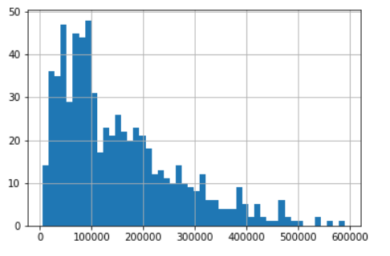
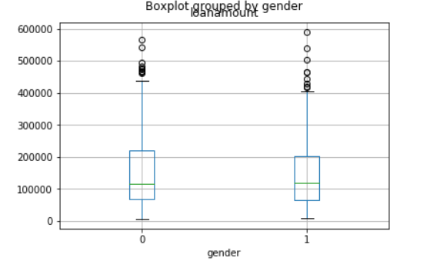
Feature Analysis
The Boxplot graph here shows, the outliers of Loan amount were more on ‘Male ‘ gender compared to ‘Female’
Box grouped by gender
Loan amount
Loan Amount in our dataset showed the qualities of right-skewed
Gender
Compared all the features to establish a co-relation between them and also to find the features which contributed the most to the default factor.

Slide 8
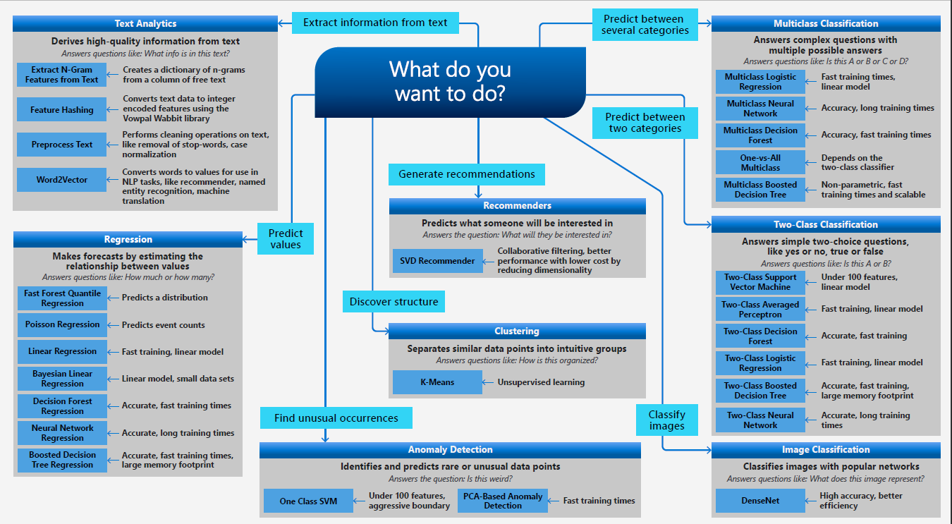
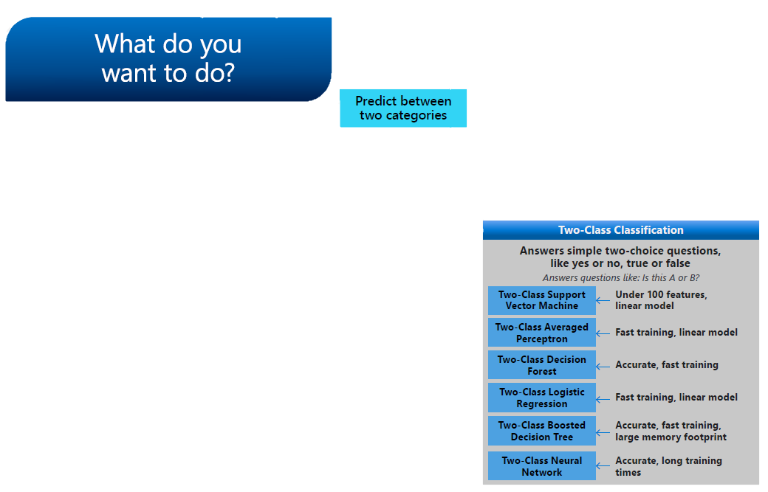
Choosing a Model
Trial and Error
Azure Cheat Sheet

Slide 9
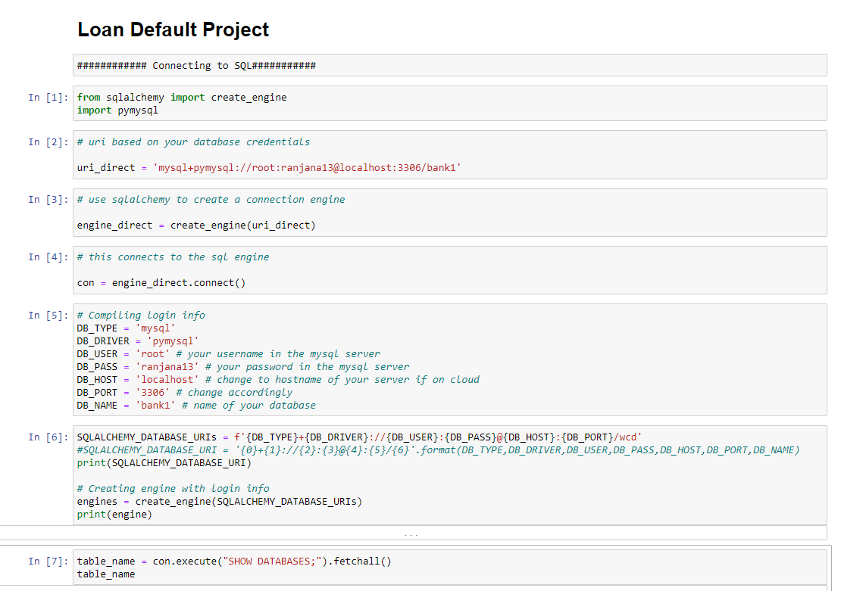

Slide 10
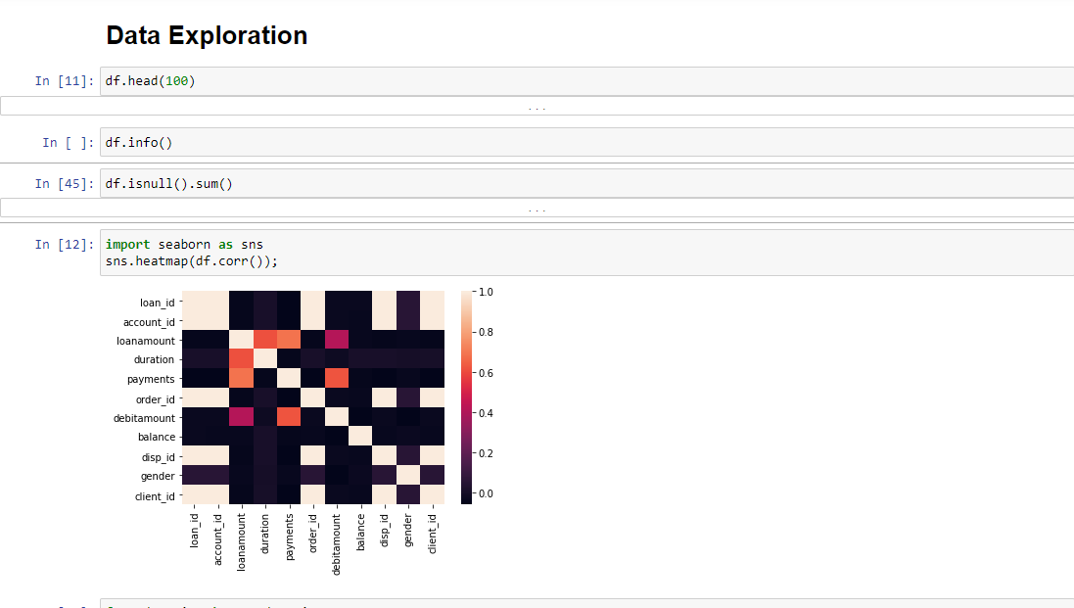

Slide 11
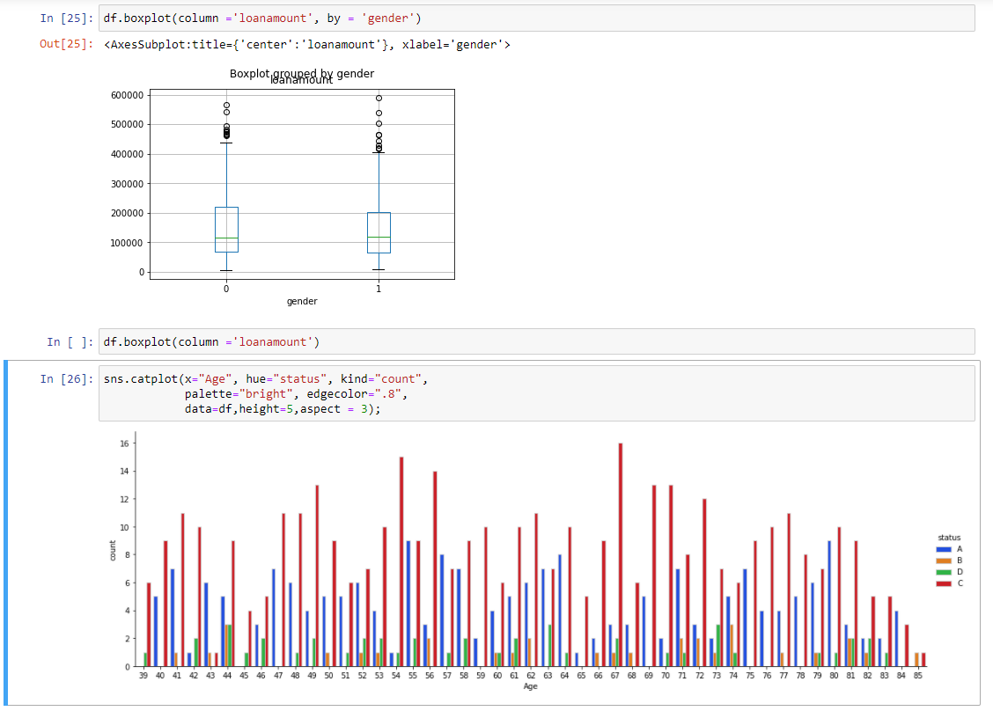

Slide 12
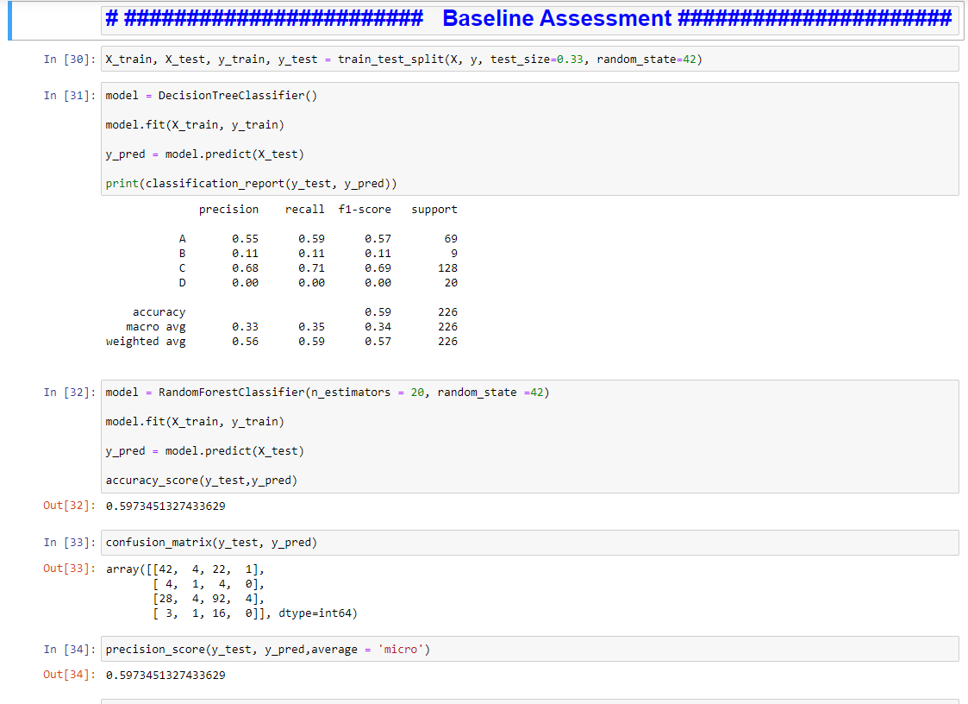

Slide 13
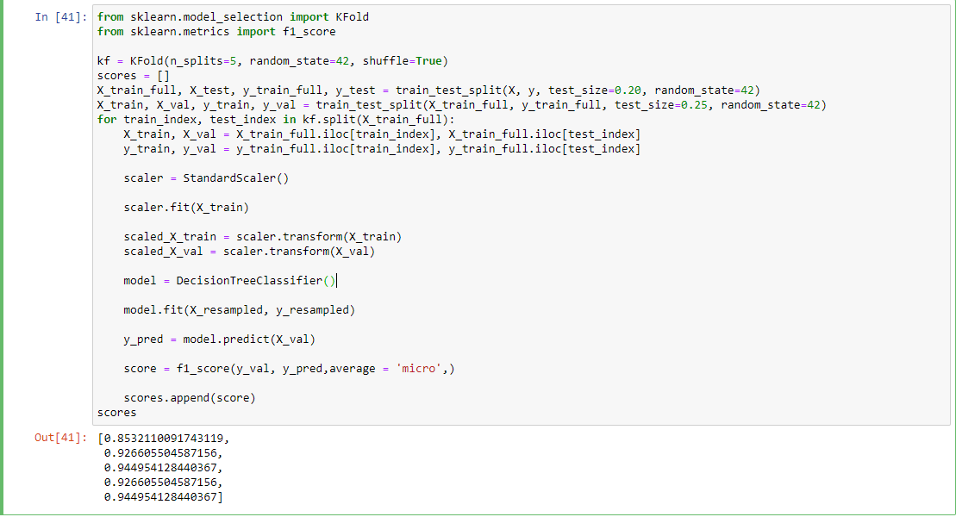

Slide 14
Prediction Model
Split 70:30
Data Leakage
Decision Tree Classifier
Random Forest Classifier
Max Depth 4
Num Estimators 6
Kfold Cross Validation
Grid Search CV
Standard Scaling
Accuracy 61%
Precision 61%
Recall 61%
6%
67%
AVG 92%

Slide 15
Strength
Opportunities
Other Algorithms
Leverage Strengths In Teams
Small Training Set
Agile Methodology
Advanced Modelling
Practical Intuition
Knowledge
Weakness
Data Cleaning
SQL
Domain Knowledge
Learning While Executing
Domain Knowledge
Time Constraints
SWOT
Python
ML

Slide 16
Conclusions
1- In the data set there was very low correlation between the attributes which can be easily visualized with heat Map.
2- The Precision score, Recall score and accuracy was 61% of our model.
3- ‘Age’ and ‘Gender had less contribution to the loan default factor, where as the Loan amount was the key player; the higher the loan amount probability of defaulting was higher.

Slide 17

What’s next?
1- If the dataset had more observations and corelating attributes our Model could have attained better precision value and recall value.
2- If a brainstorming session was used for the initial process of the project a better outcome could have been attained even with respect to time.

Slide 18
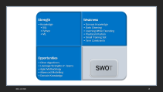
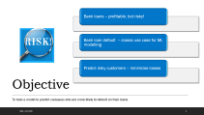
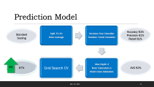
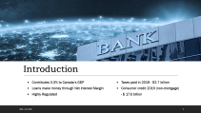
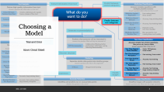
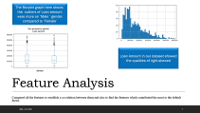
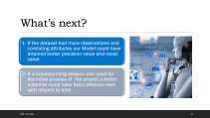
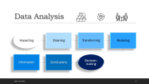
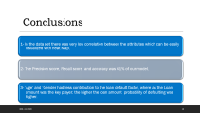
Questions?

